Slide 1

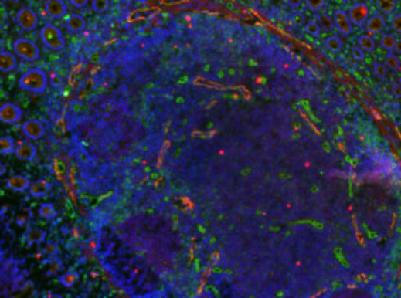
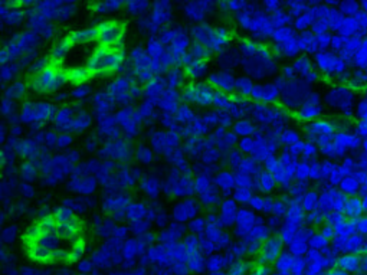
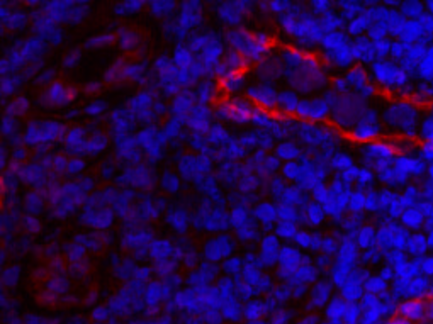
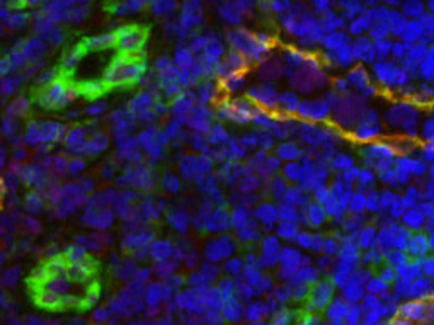
ReliaTech GmbH
Rabbit anti-human LYVE-1
(Cat #102-PA50)
A
LYVE-1, a marker for lymphatics!
The staining was performed on cryosections from human colon carcinoma using RELIATech’s polyclonal anti-human LYVE-1 antibody (Protein-A purified; 10μg/ml).
A
B
C
The experiments were perfomed by Dr. Ulrike Fiedler and Stefanie Koidel, Dept. of Vascular Biology and Angiogenesis Research
Tumor Biology Center, Breisacher Str. 117, D-79106 Freiburg, Germany
http://www.reliatech.de / orders@reliatech.de

